Slide 1
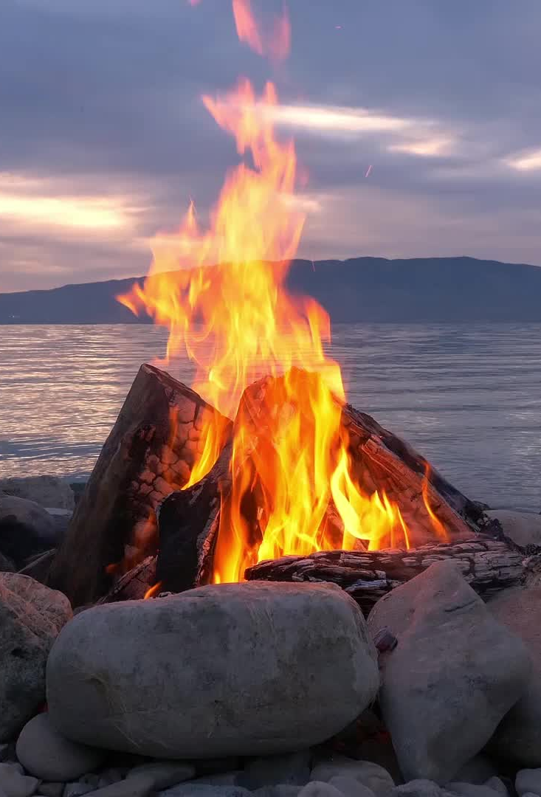
Start a fire

Slide 2
Verse 1
This world can be cold and bitter
Feels like we're in the dead of winter
Waiting on something better
But am I really gonna hide forever?

Slide 3
Verse 1
Over and over again
I hear Your voice in my head
Let Your light shine,
let Your light shine
for all to see

Slide 4
Chorus
Start a fire in my soul
Fan the flame and make it grow
So there’s no doubt or denying

Slide 5
Chorus
Let it burn so brightly
That everyone around can see
That it’s You, that it’s You that we need
Start a fire in me

Slide 6
Verse 2
You only need a spark to start a whole blaze
It only takes a little faith
Let it start right here in this city
So these old walls will never be the same

Slide 7
Verse 2
Over and over again
I hear Your voice in my head
They need to know
I need to go
Spirit won't You fall on my heart now

Slide 8
Chorus
Start a fire in my soul
Fan the flame and make it grow
So there’s no doubt or denying

Slide 9
Chorus
Let it burn so brightly
That everyone around can see
That it’s You, that it’s You that we need
Start a fire in me

Slide 10
Bridge
You are the fire You are the flame
You are the light on the darkest day

Slide 11
Bridge
We have the hope we bear Your name
We carry the news that You have come to save
Only You can save

Slide 12
Chorus
Start a fire in my soul
Fan the flame and make it grow
So there’s no doubt or denying

Slide 13
Chorus
Let it burn so brightly
That everyone around can see
That it’s You, that it’s You that we need
Start a fire in me

Slide 14
Bridge
You are the fire You are the flame
You are the light on the darkest day

